Slide 1

Modular environment Design Or how I learned to stop worrying and love the grid!

Slide 2
Kevin Johnstone
Senior Environment Artist
Scotland – Quake – 1st job at Reflections
Met a woman ,travelled round Europe
Developed a love of European buildings
Built my portfolio up until I could get to Epic

Slide 3


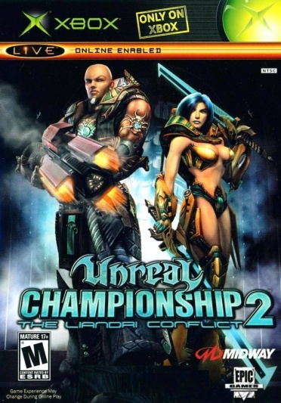




Shipped Titles

Slide 4
What I do at Epic
I make fancy pieces of LEGO for Level Designers
Concept artist – Environment Artist – LD’s
Shelling first – Visuals After
My goal is to make art that the LD’s can use

Slide 5
Main Environment art problems
Time required to author content
Heavier texture load ( D + S + E + N )
Maintaining texture resolution
Building pieces that are useful and adaptable

Slide 6
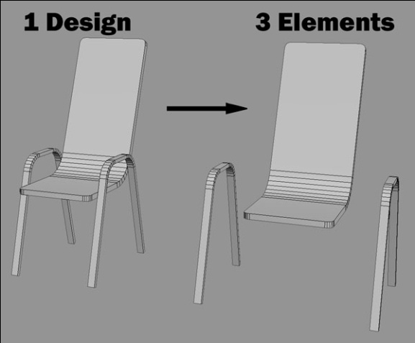
Element based modularity
Spotting the patterns of repetition
Most designs are a number of merged elements
Grid allows superior control of elements

Slide 7


Slide 8
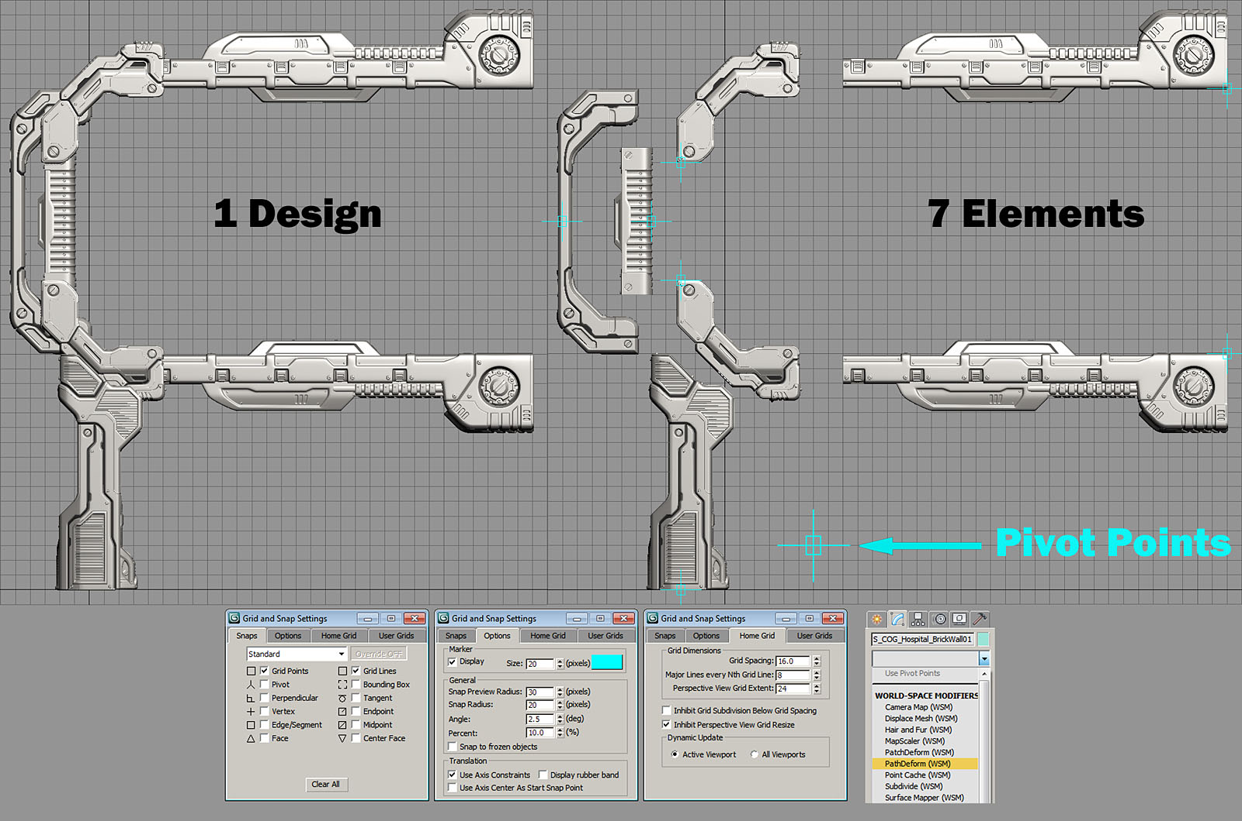

Slide 9
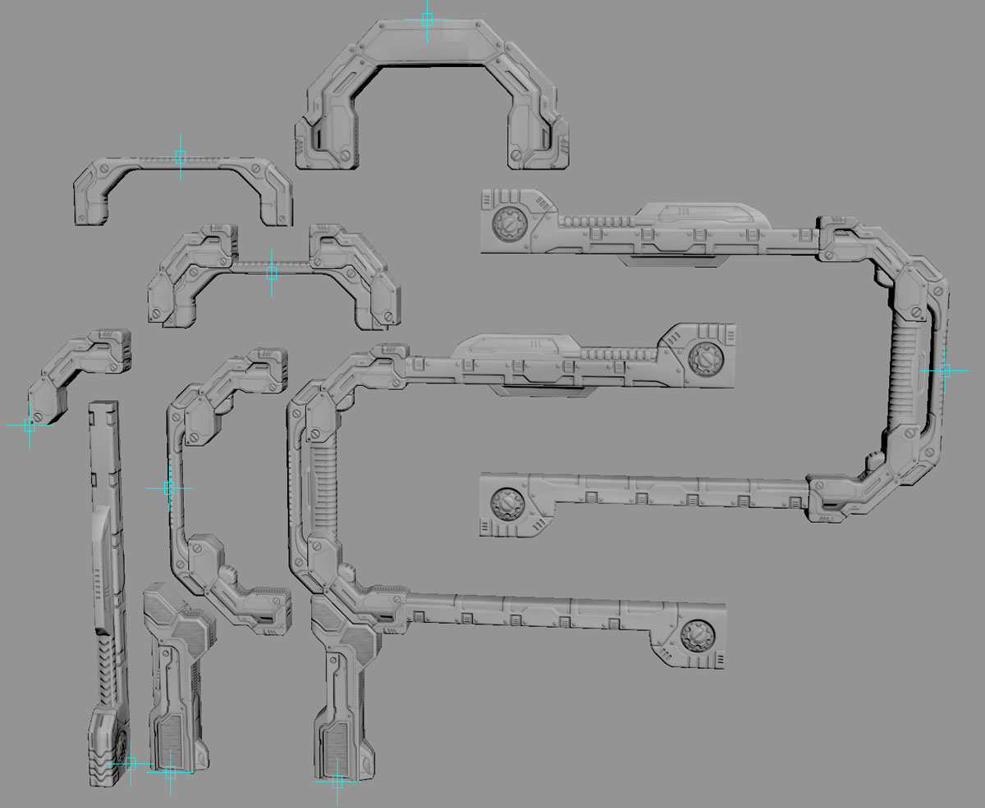

Slide 10
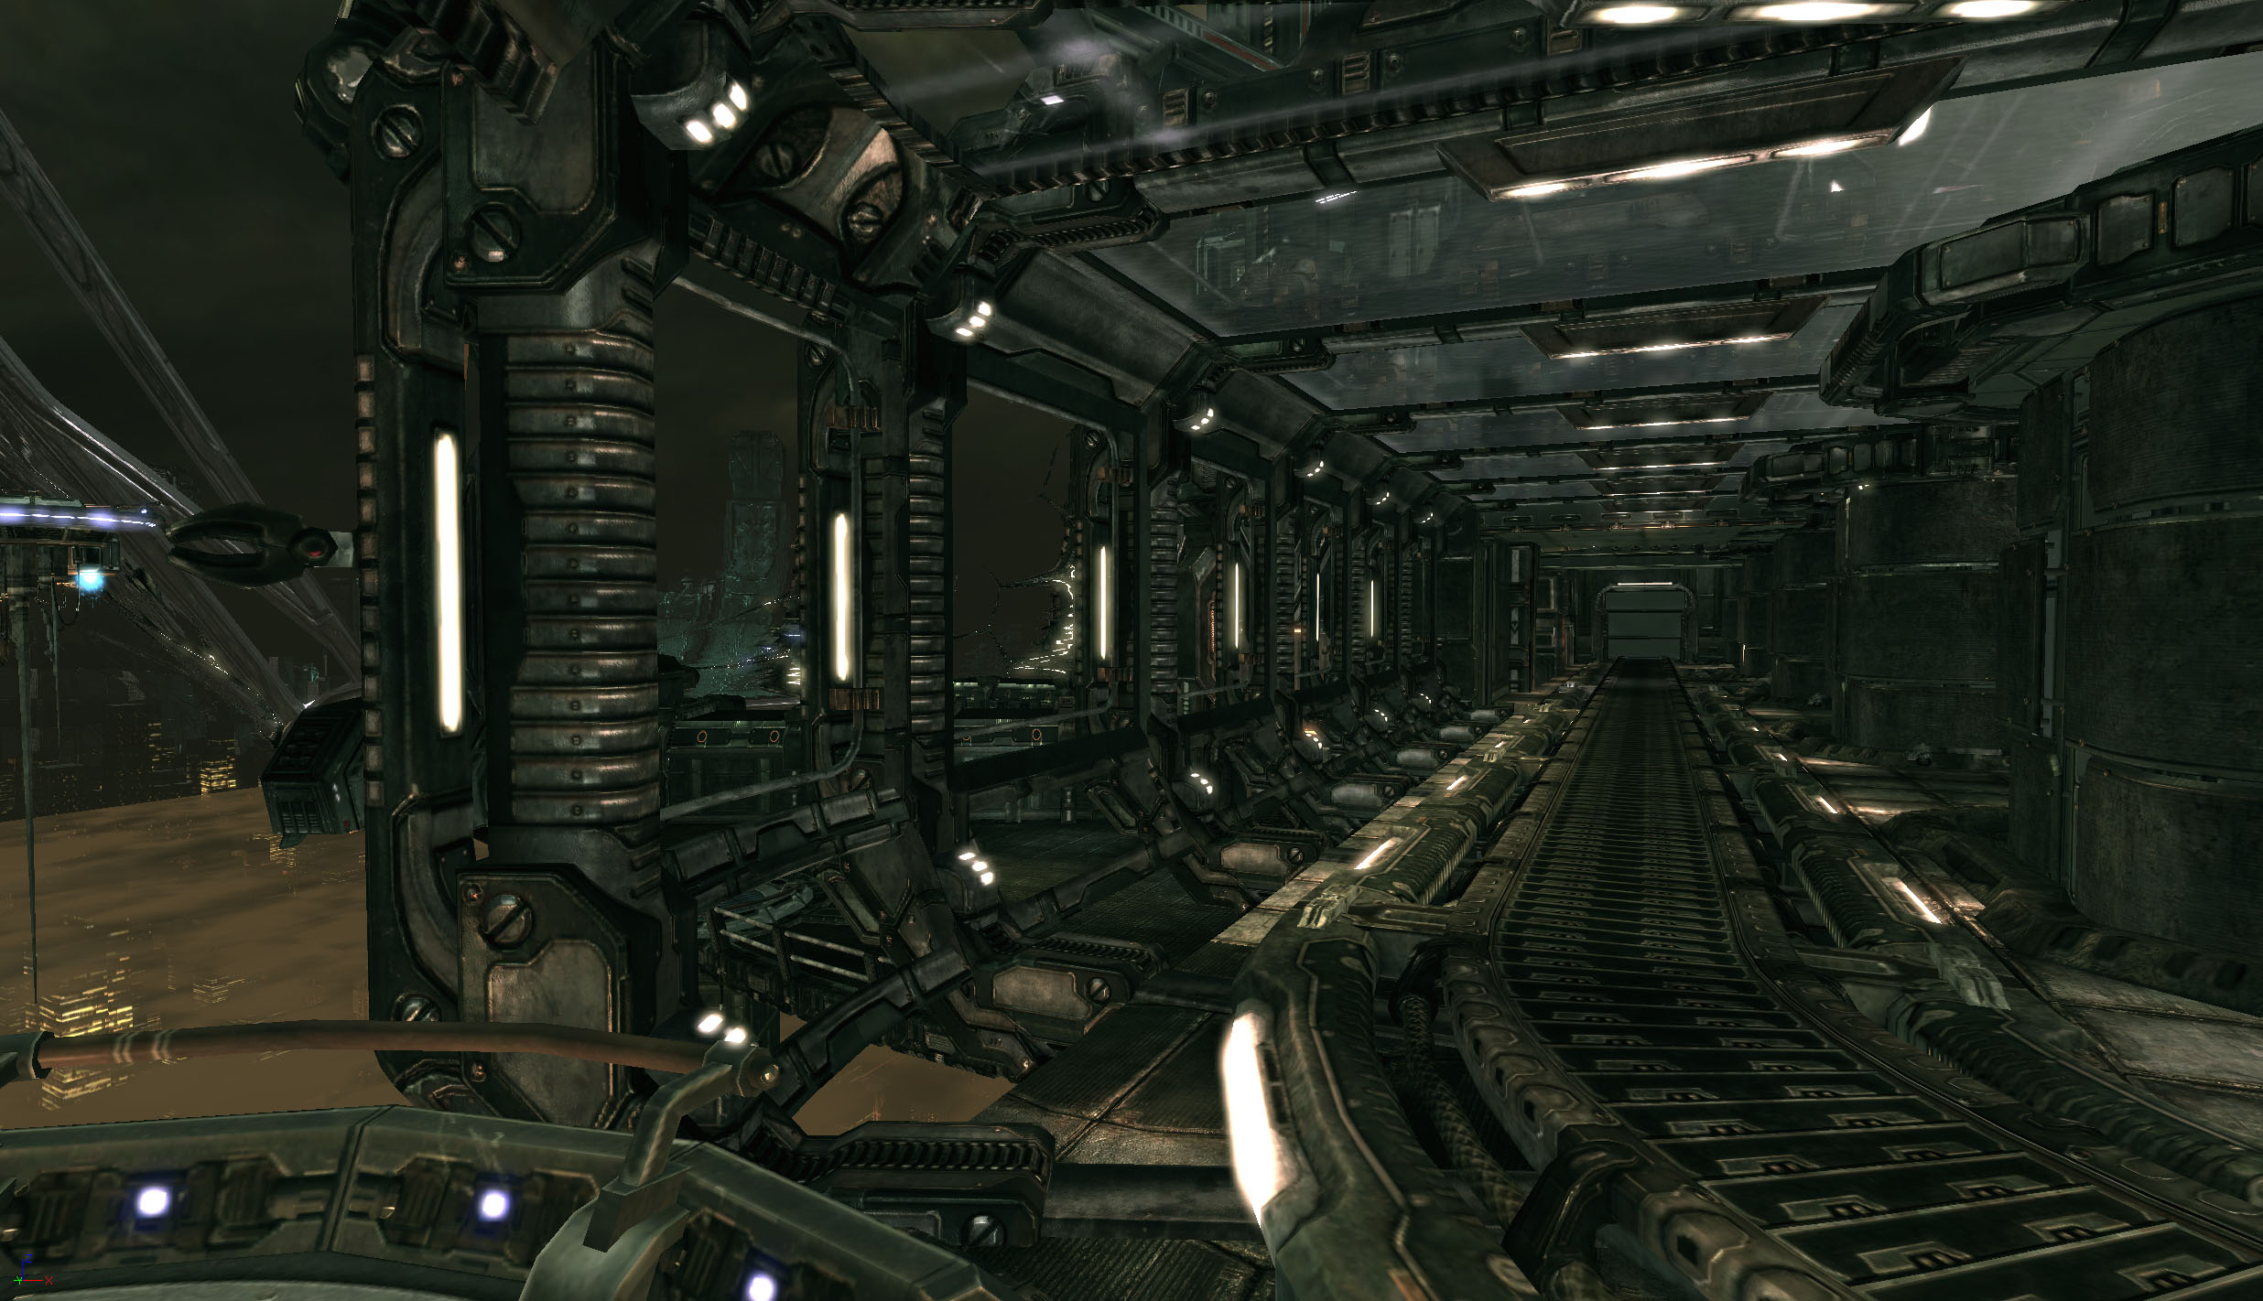

Slide 11
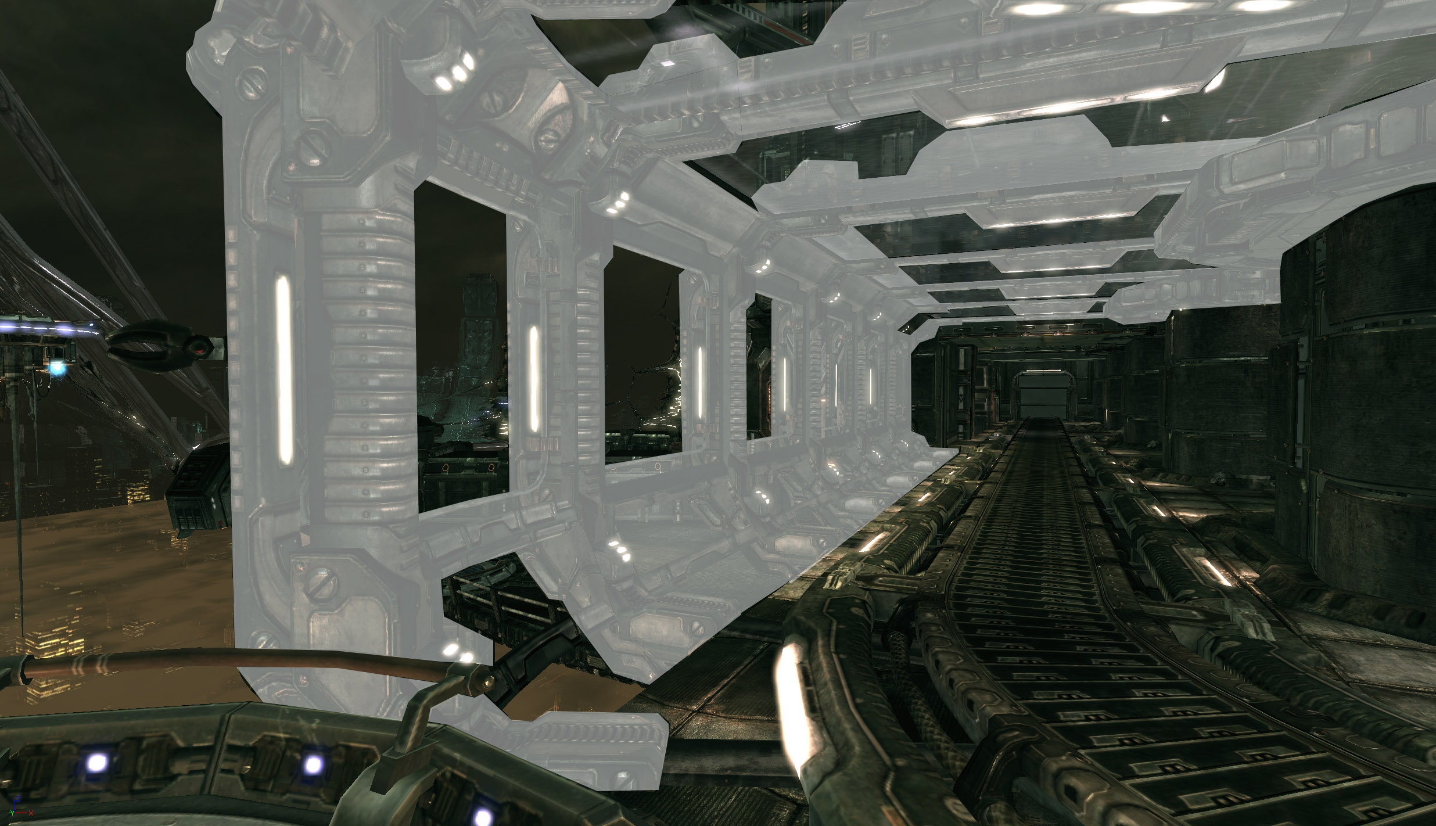

Slide 12
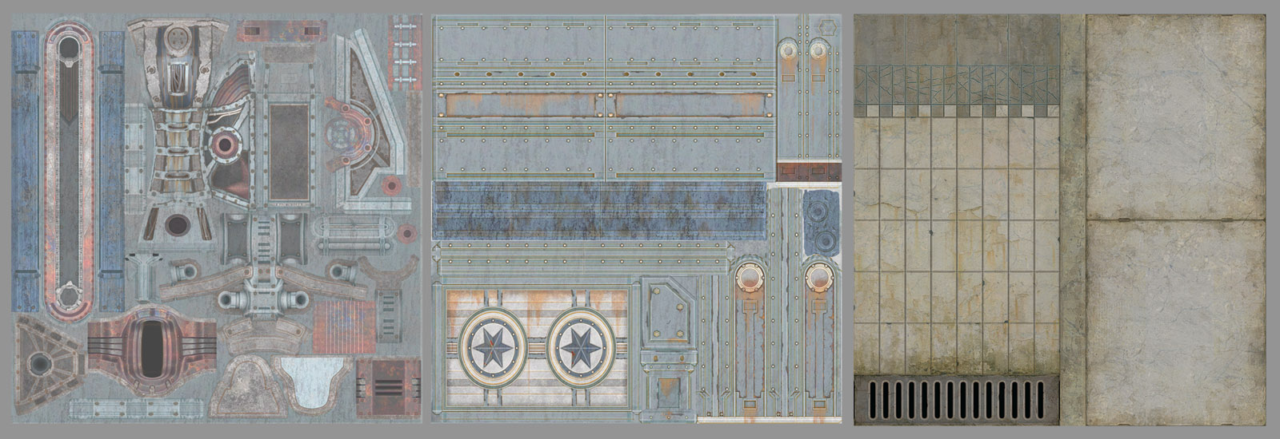
Is a rectangle also a half circle?
Complex designs - complex UVW’s
Simpler shapes - more texture res

Slide 13
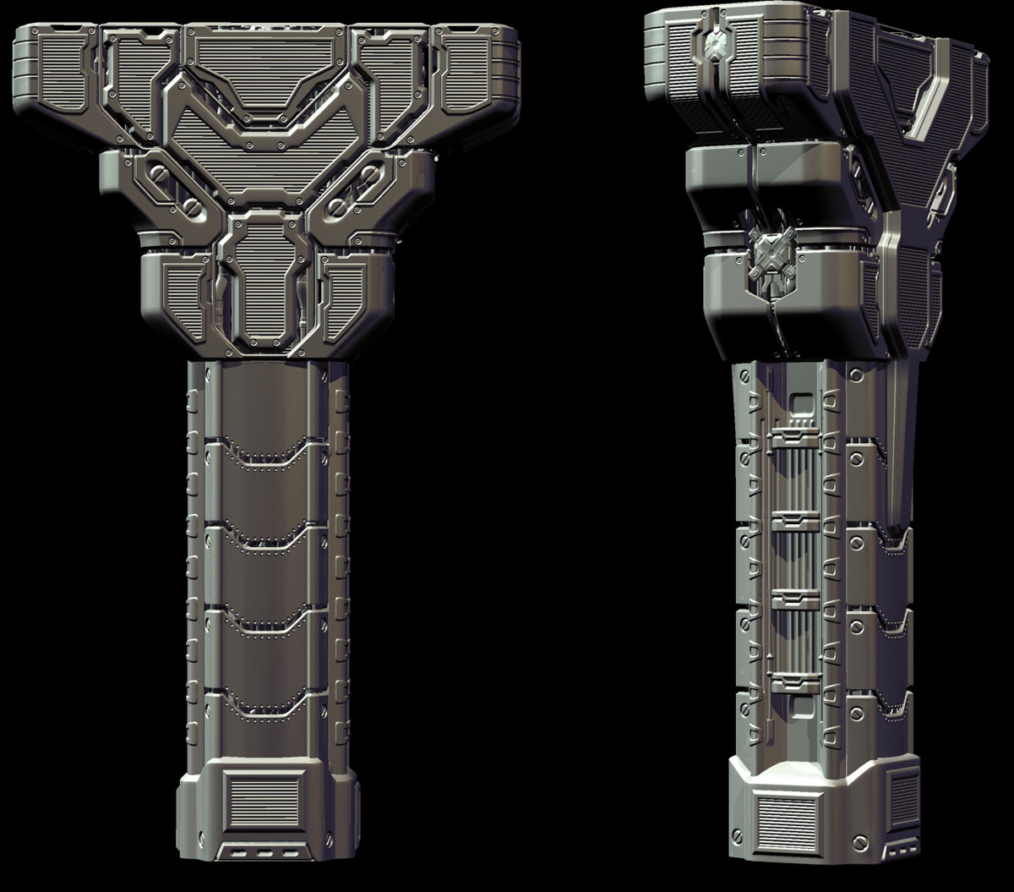

Slide 14
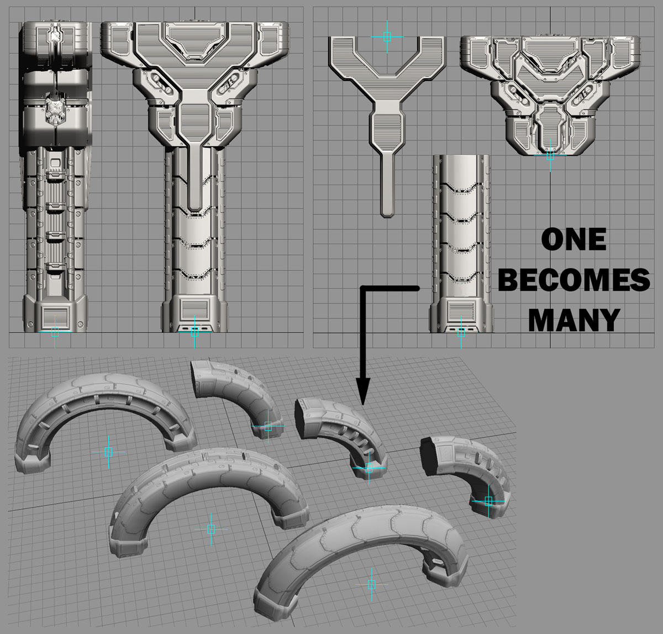

Slide 15
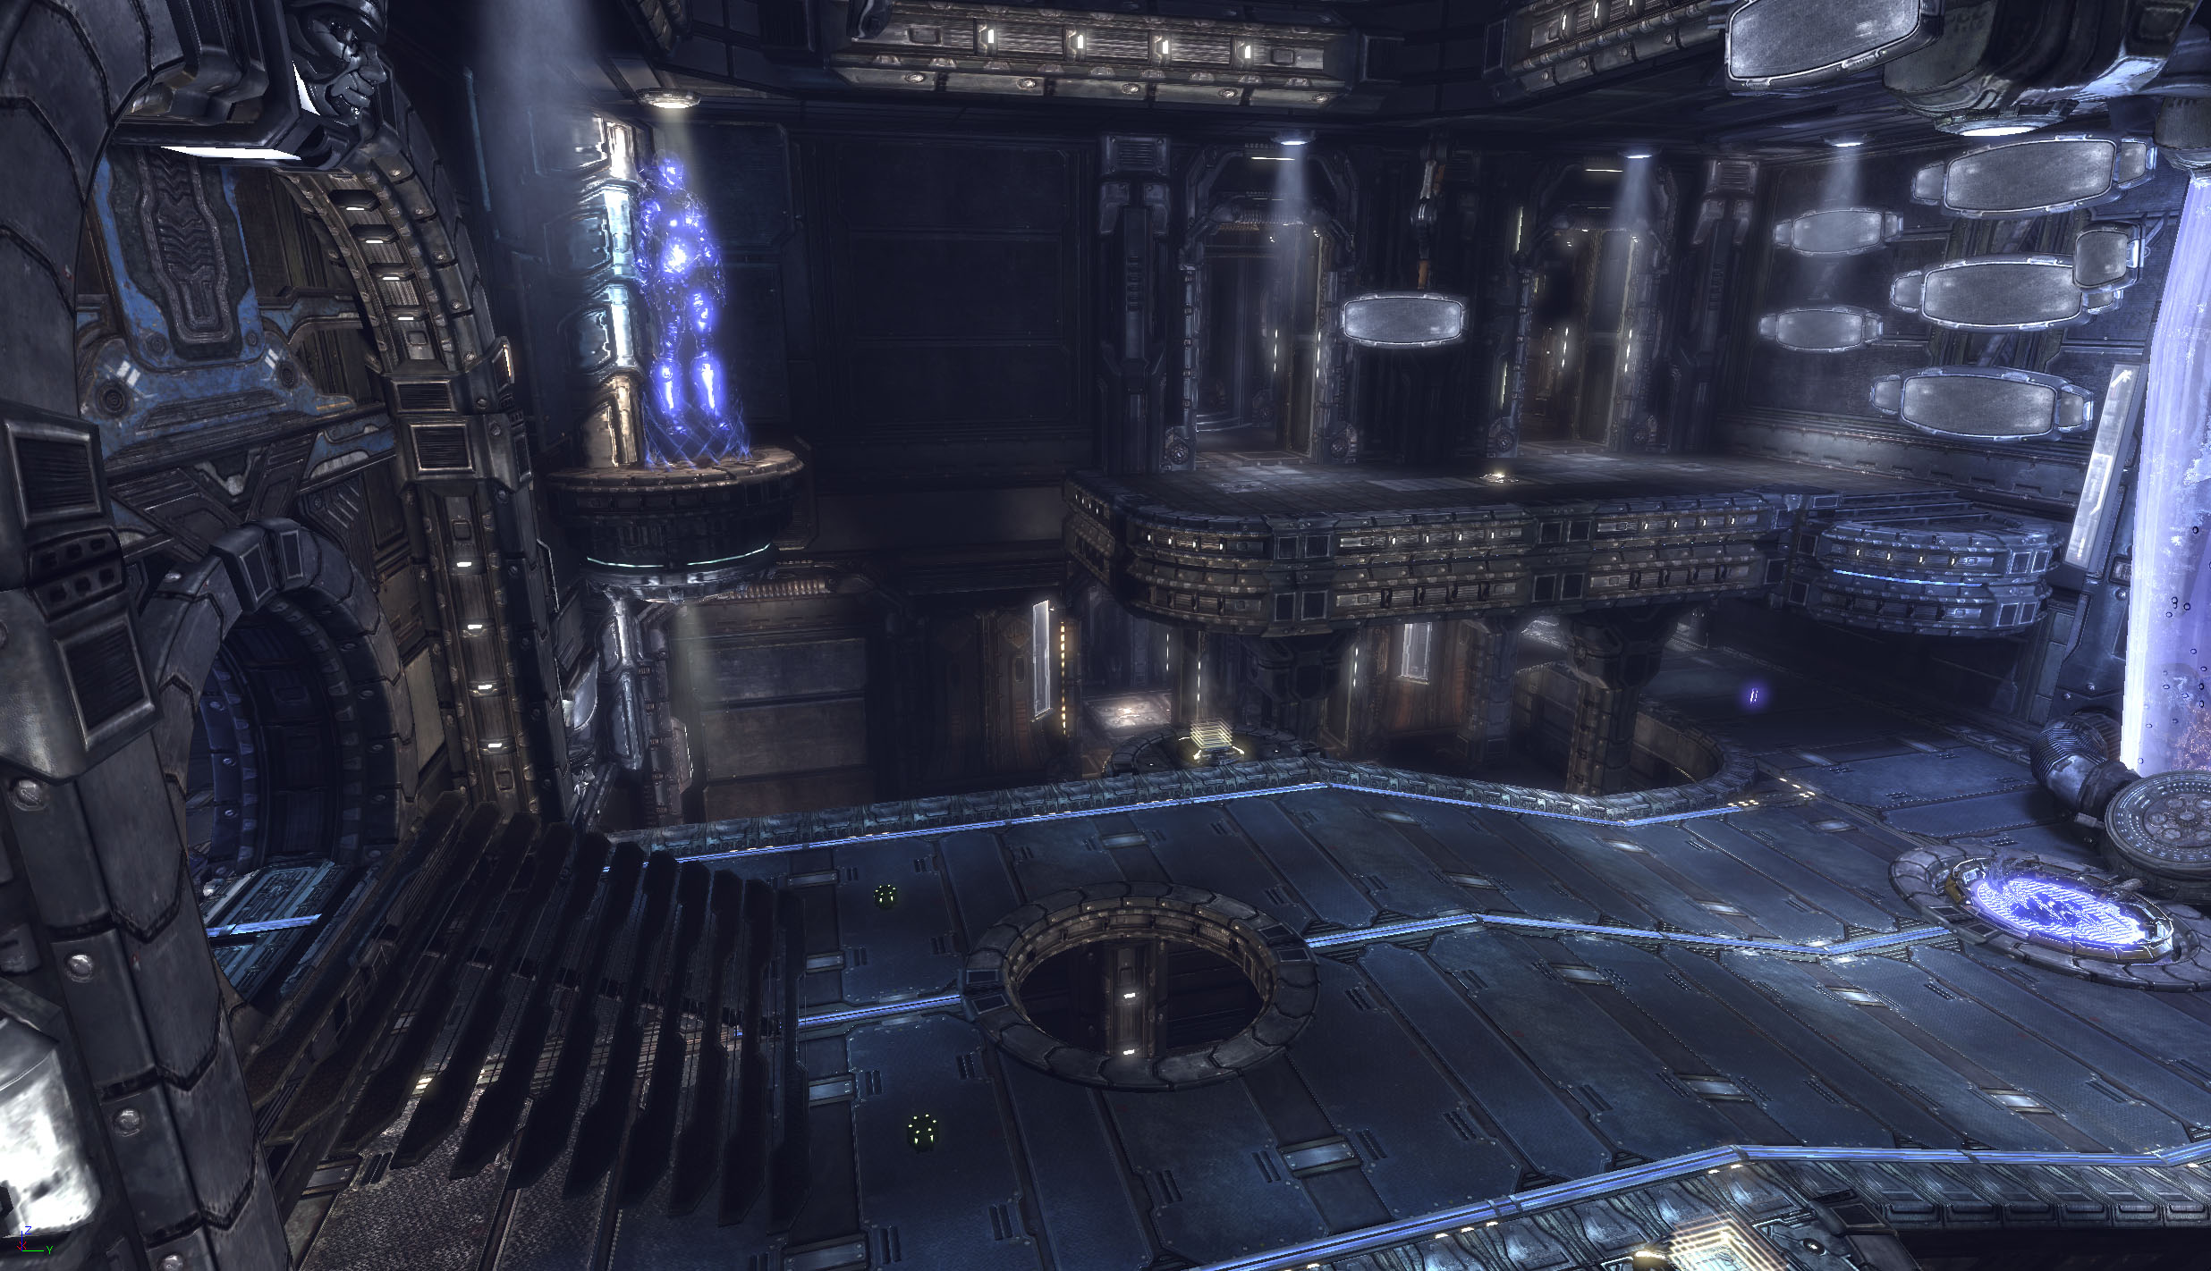

Slide 16
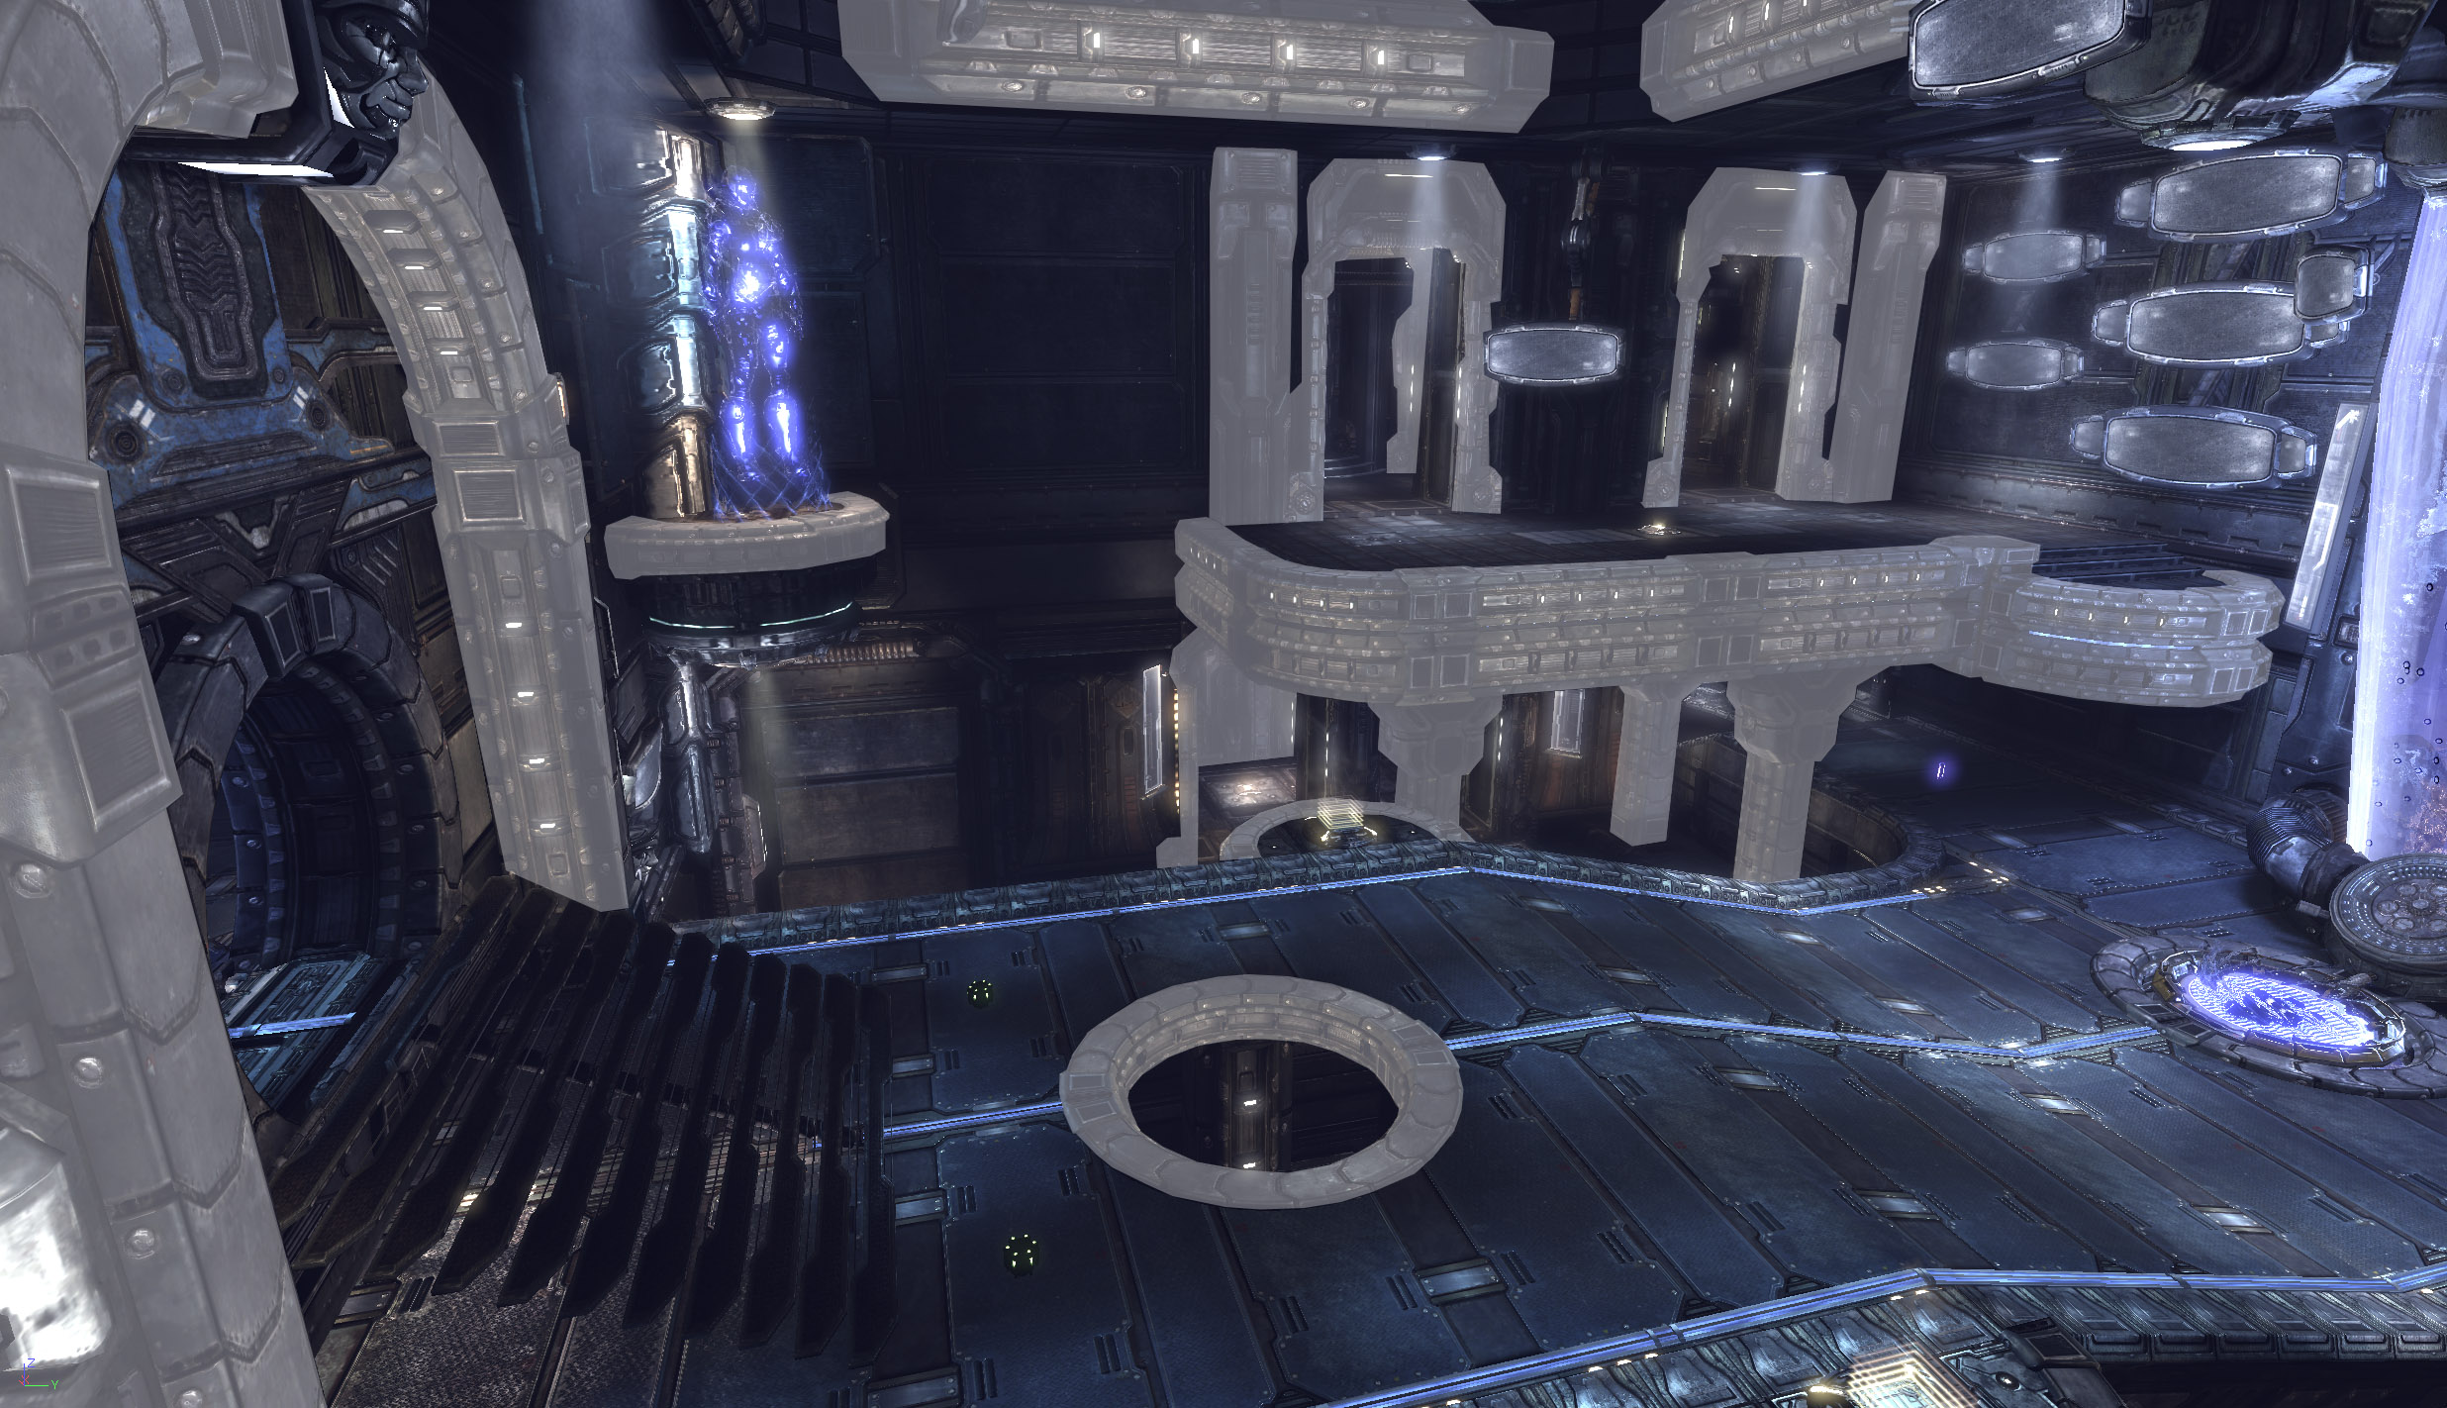

Slide 17

Lessons learned?
Repetition of forms = authenticity
Rate of production UP - Texture load DOWN
Asset count

Slide 18

Taking off
Production of more meshes at once
Simplified UVW’s
The return of BSP walls ( sort of )

Slide 19
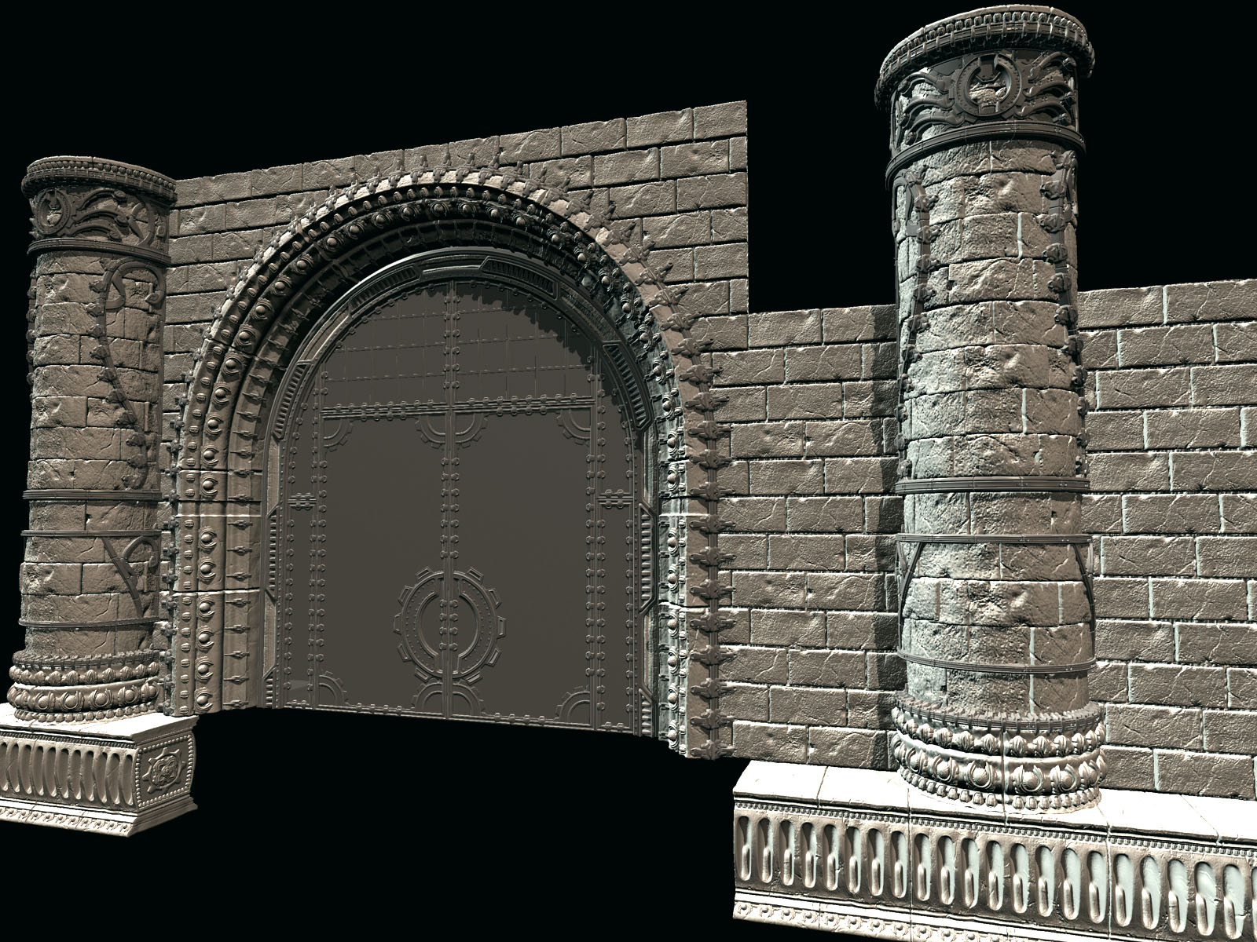

Slide 20
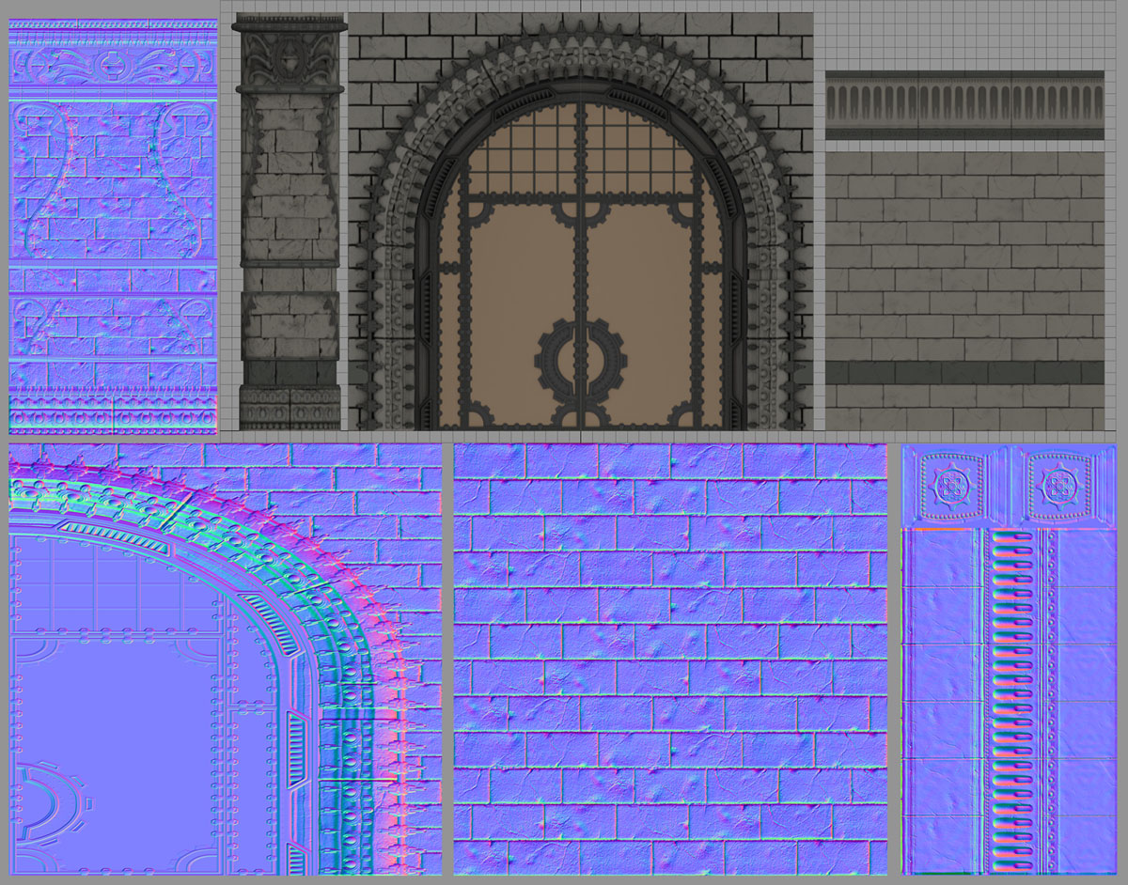

Slide 21
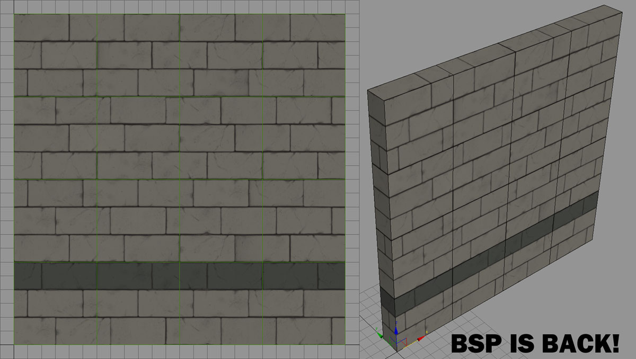

Slide 22
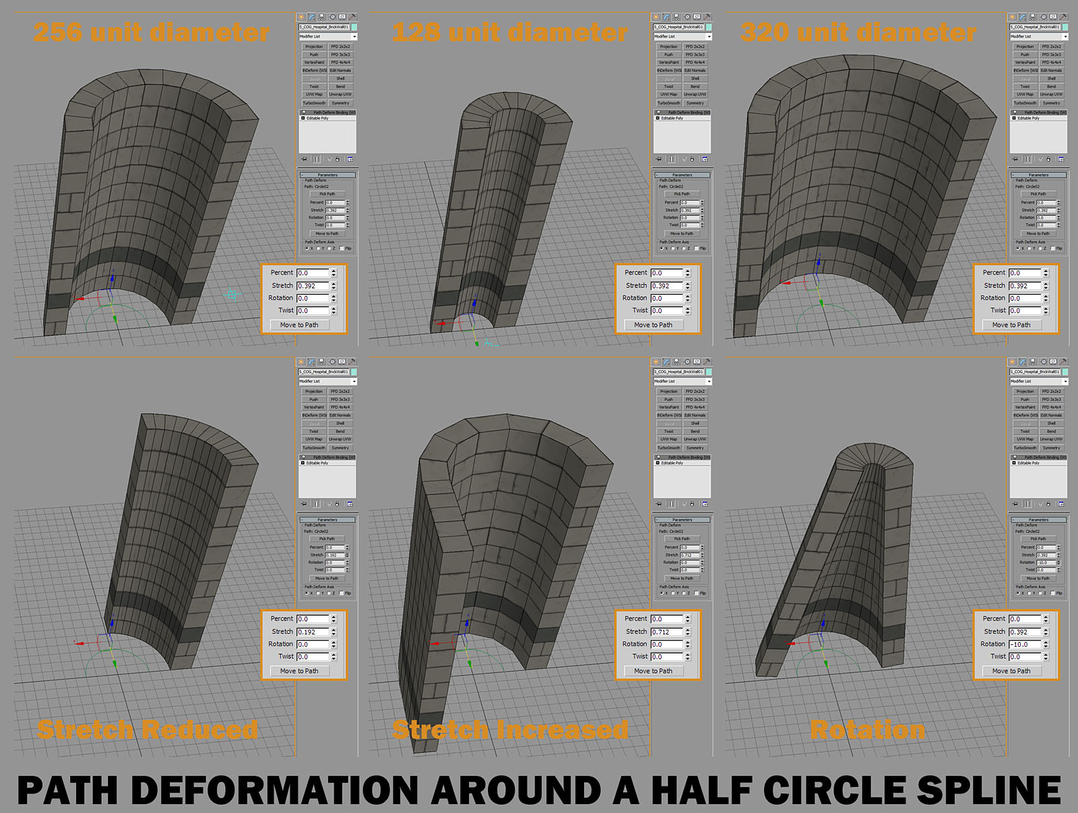

Slide 23
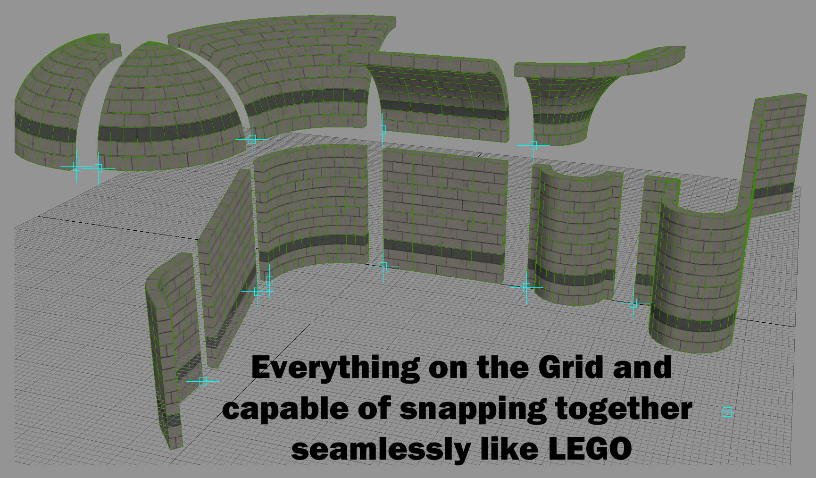

Slide 24
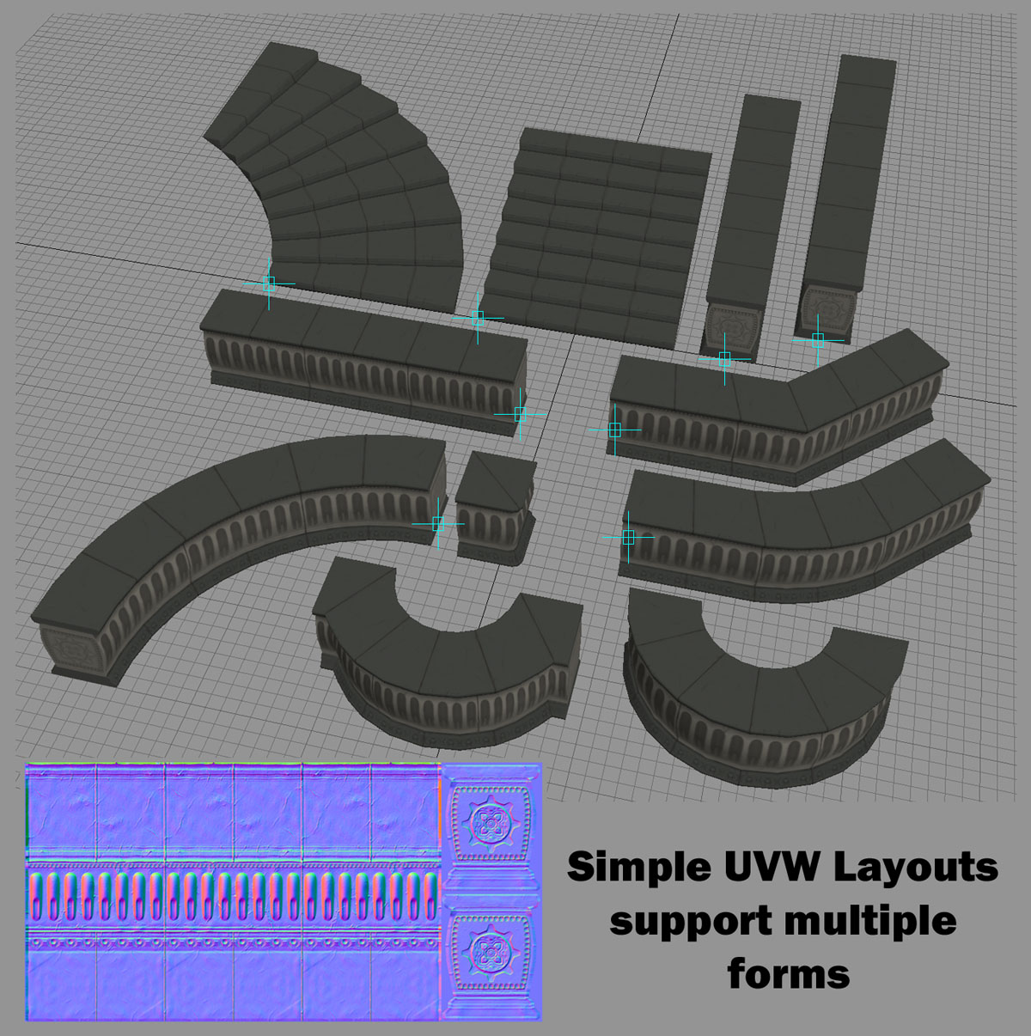

Slide 25
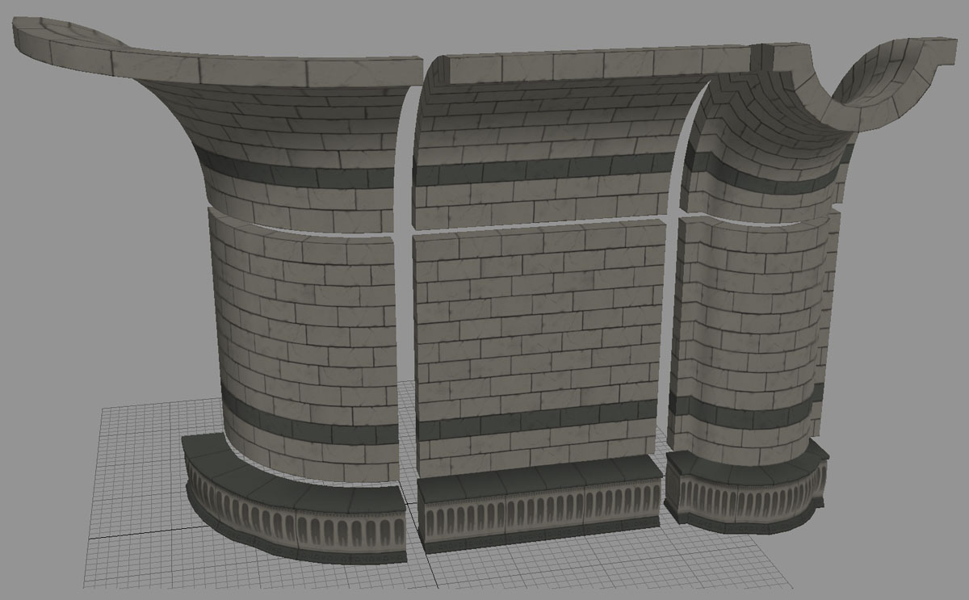

Slide 26

Gears 3 ambitions
It has to be bigger!
Planning ahead
Robust asset creation

Slide 27
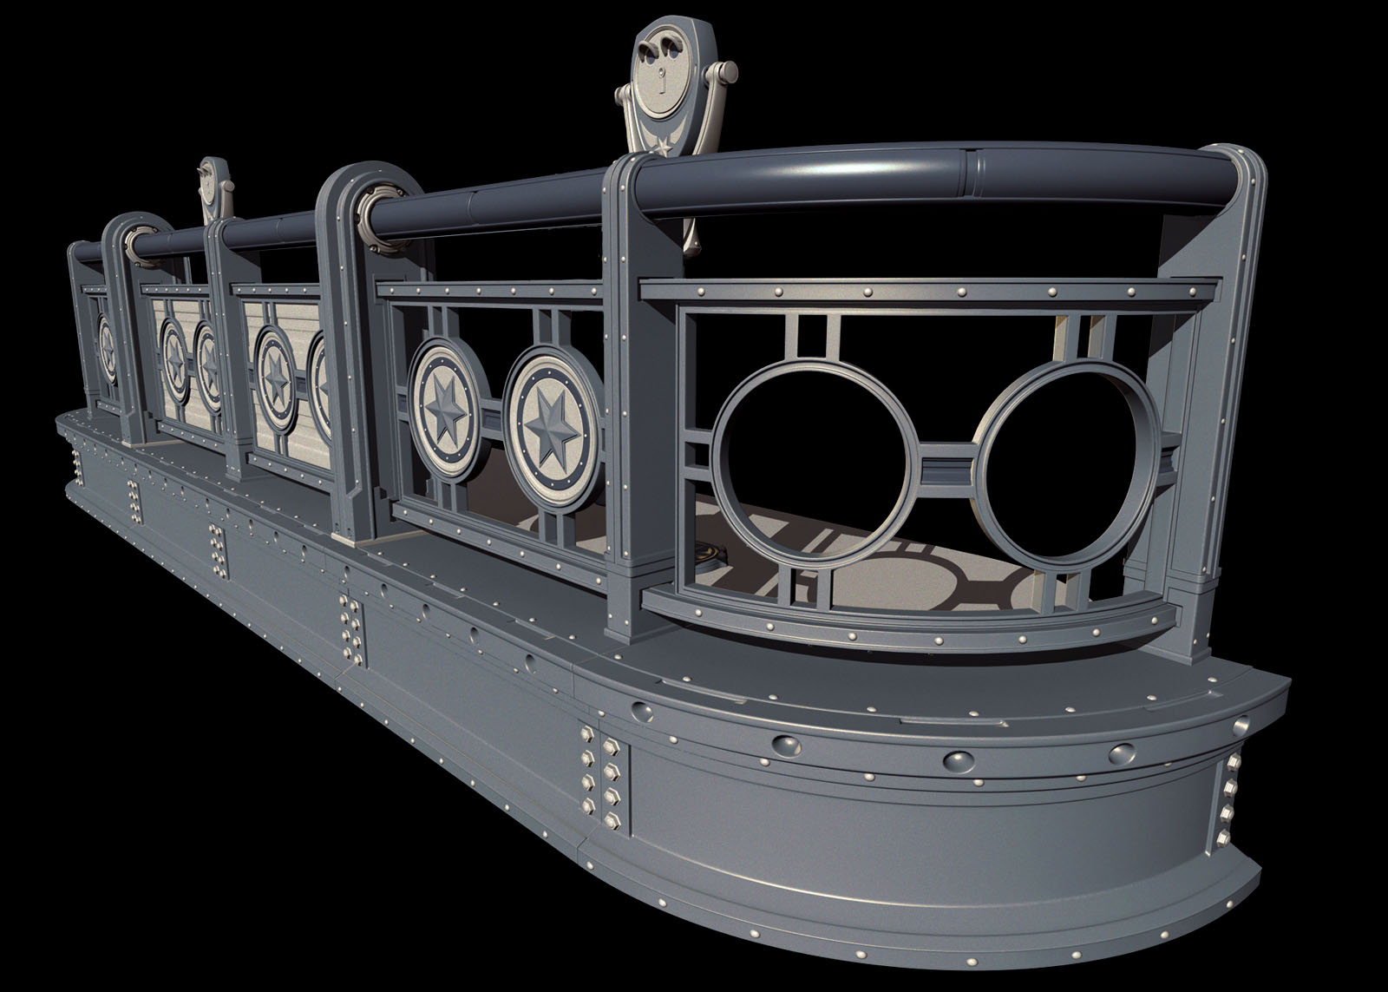

Slide 28
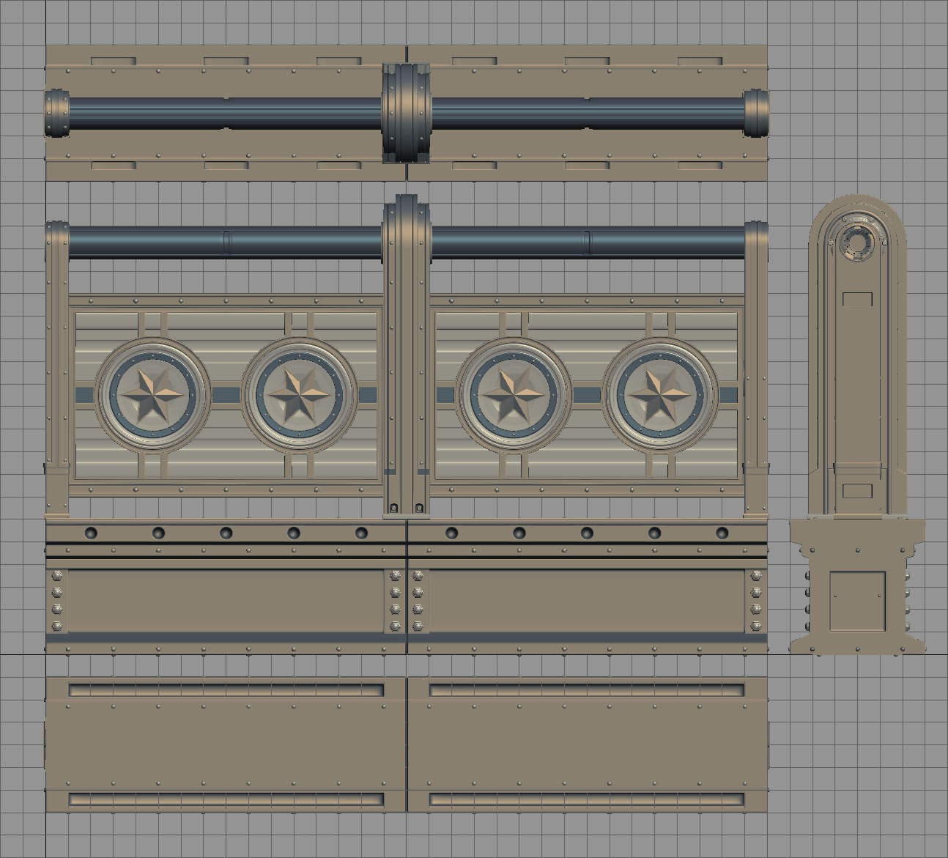
Becoming obsessive with the Grid, Trust it and it will help you

Slide 29
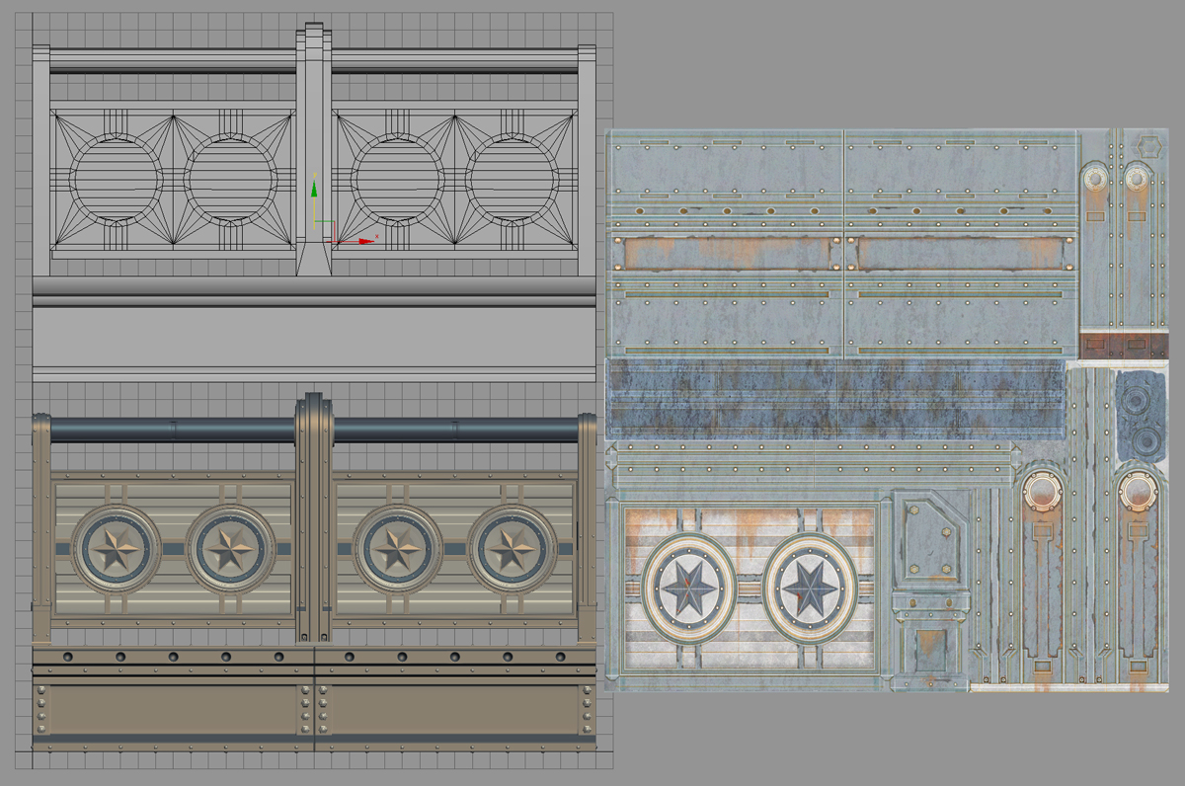
Processing is how we transfer from detailed meshs to simple ones

Slide 30
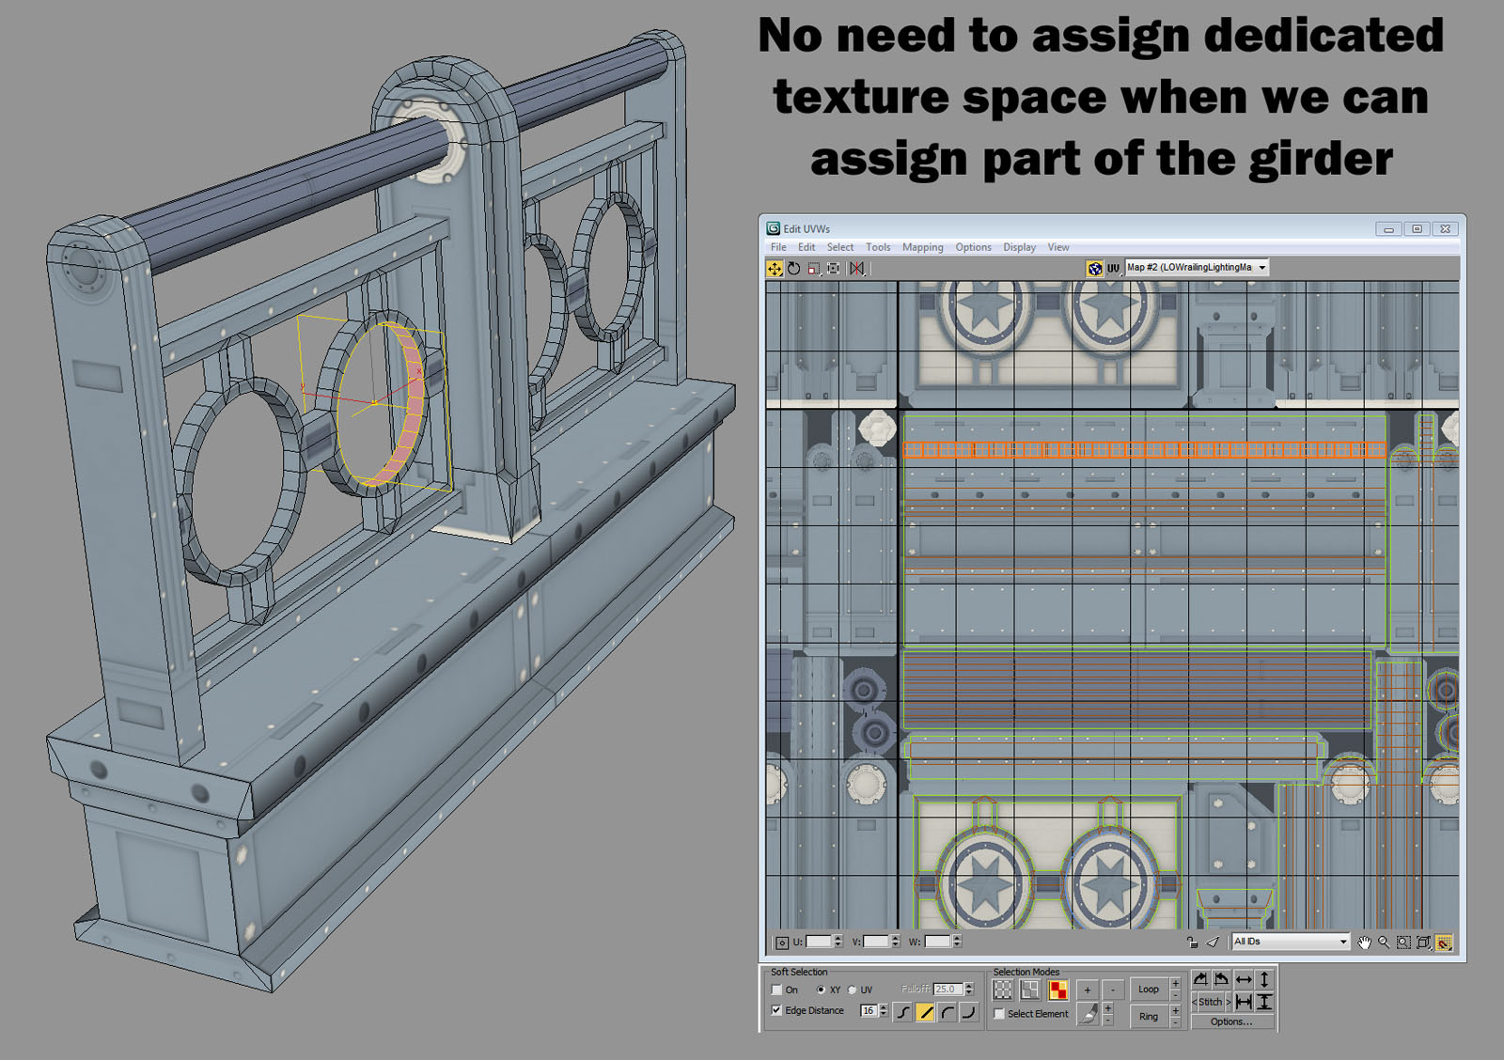

Slide 31
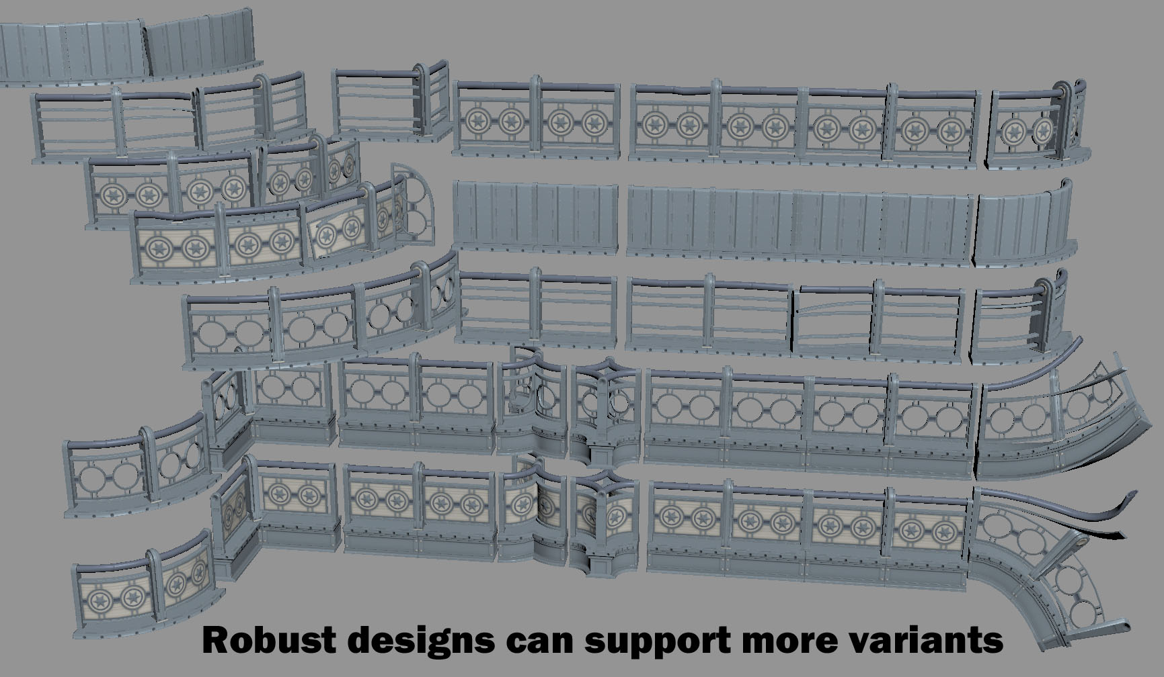

Slide 32
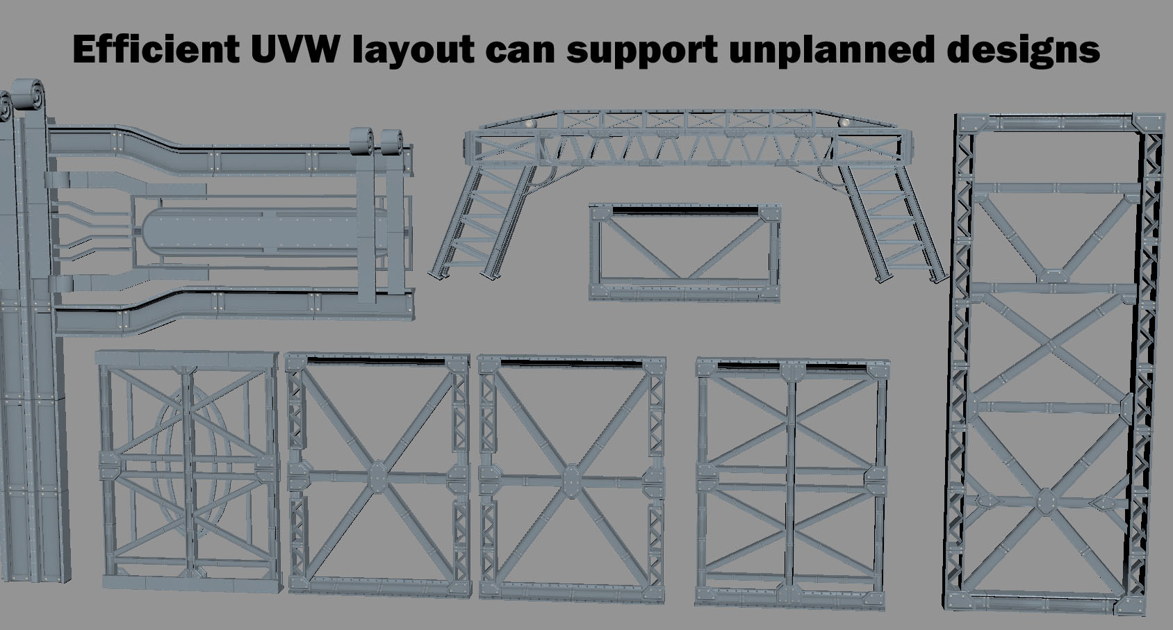

Slide 33
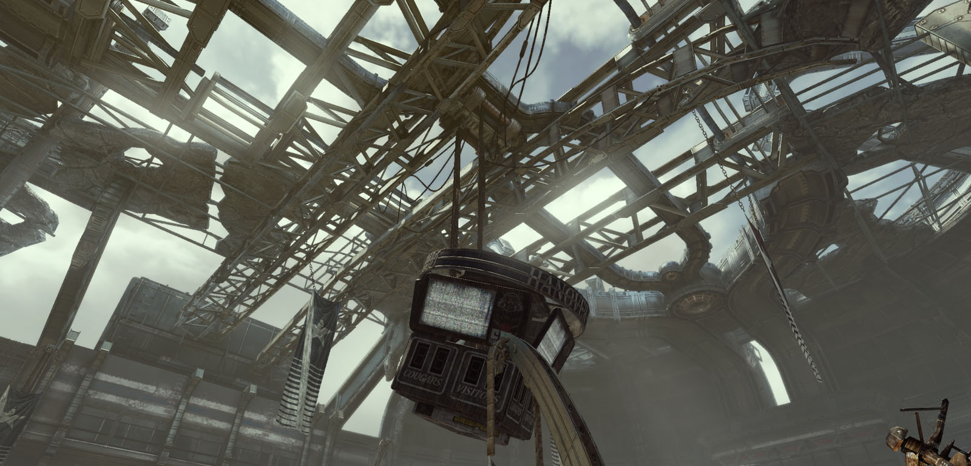
You NEVER know for sure how the art will be used in game

Slide 34
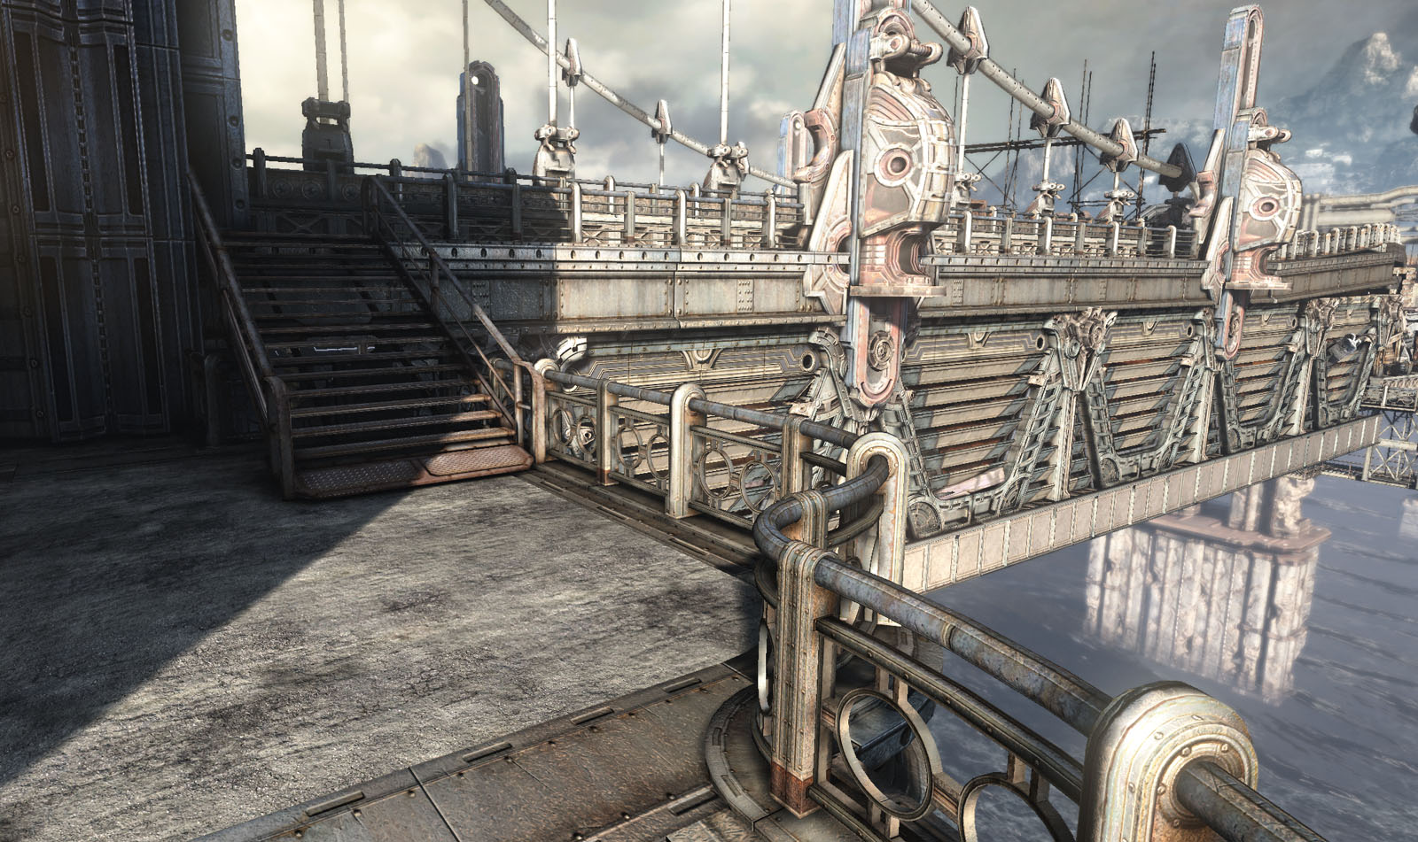

Slide 35

Completing the mission
Optimization
Problem solving

Slide 36
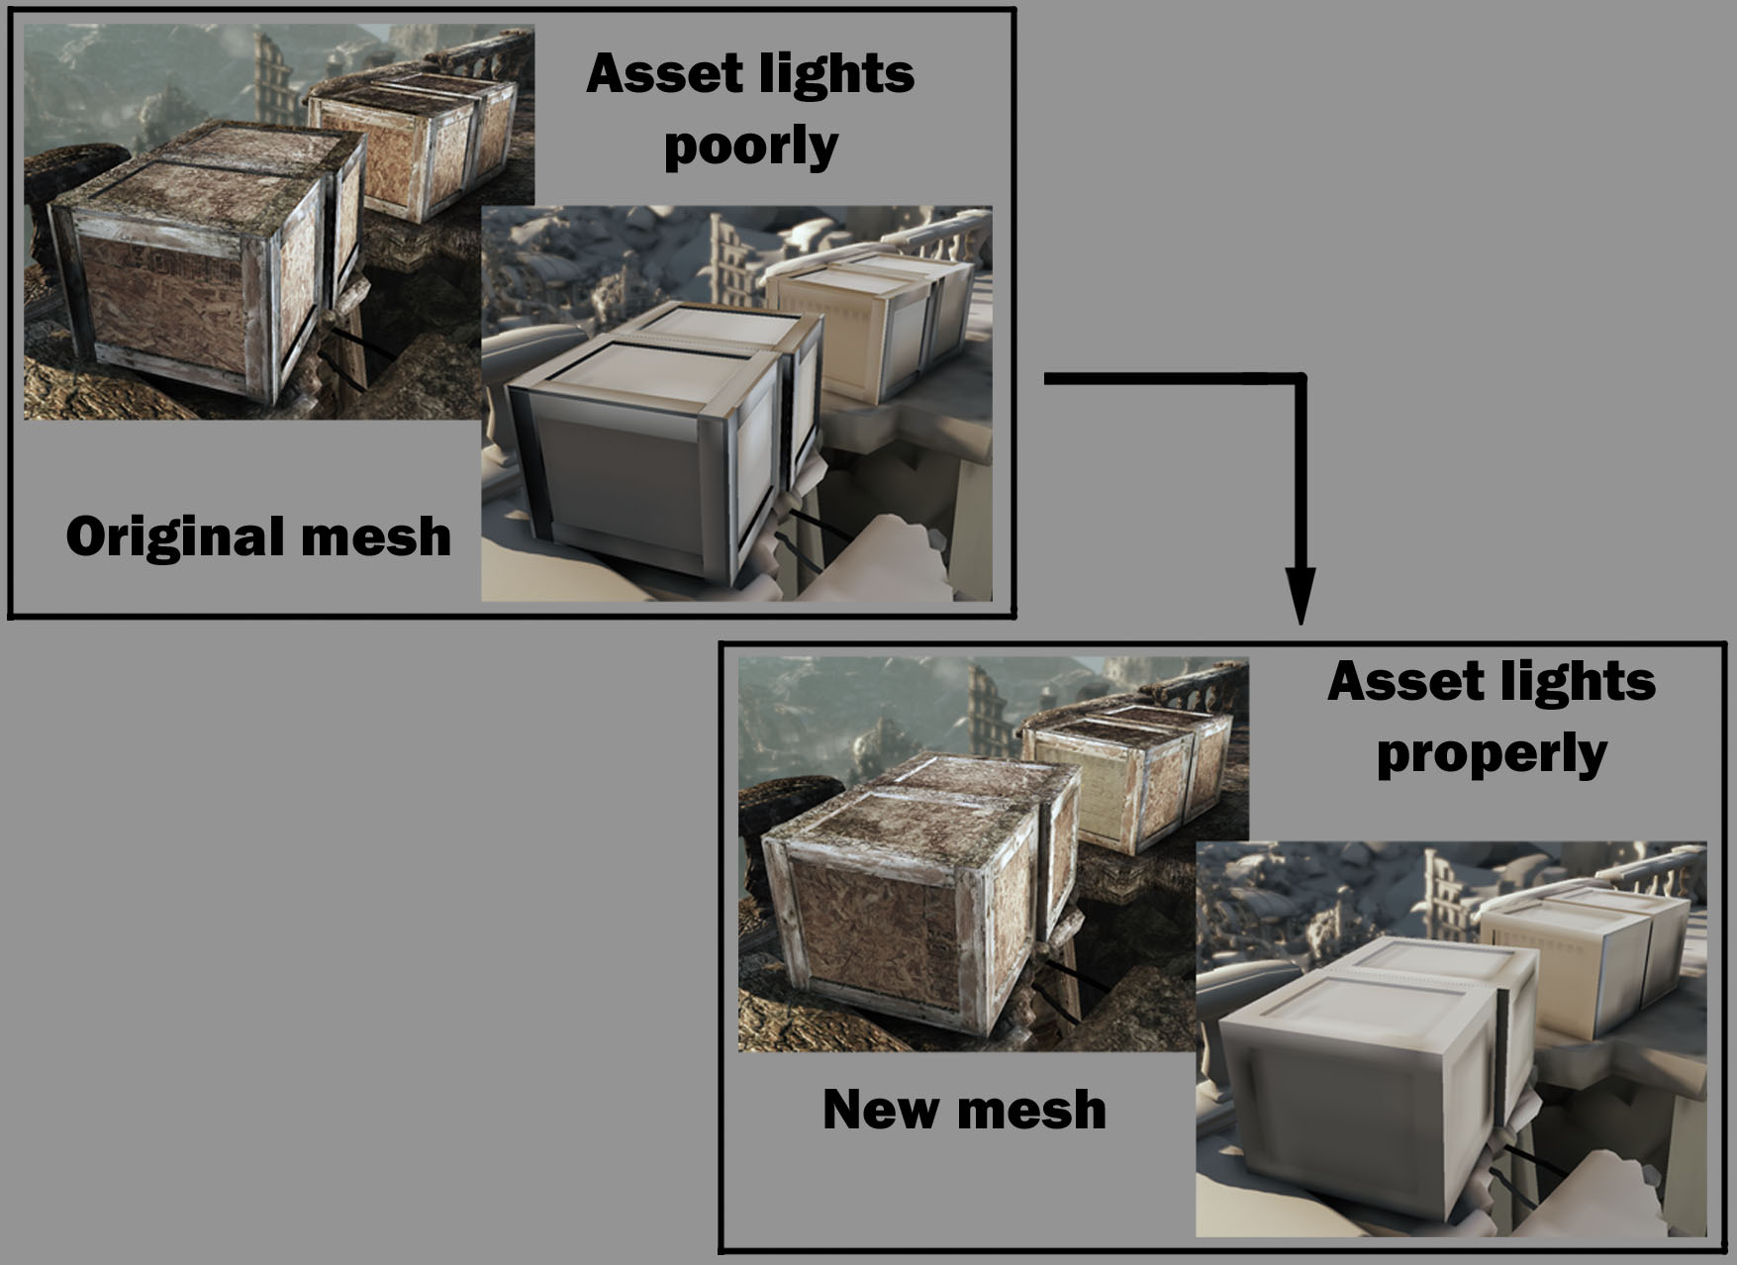

Slide 37
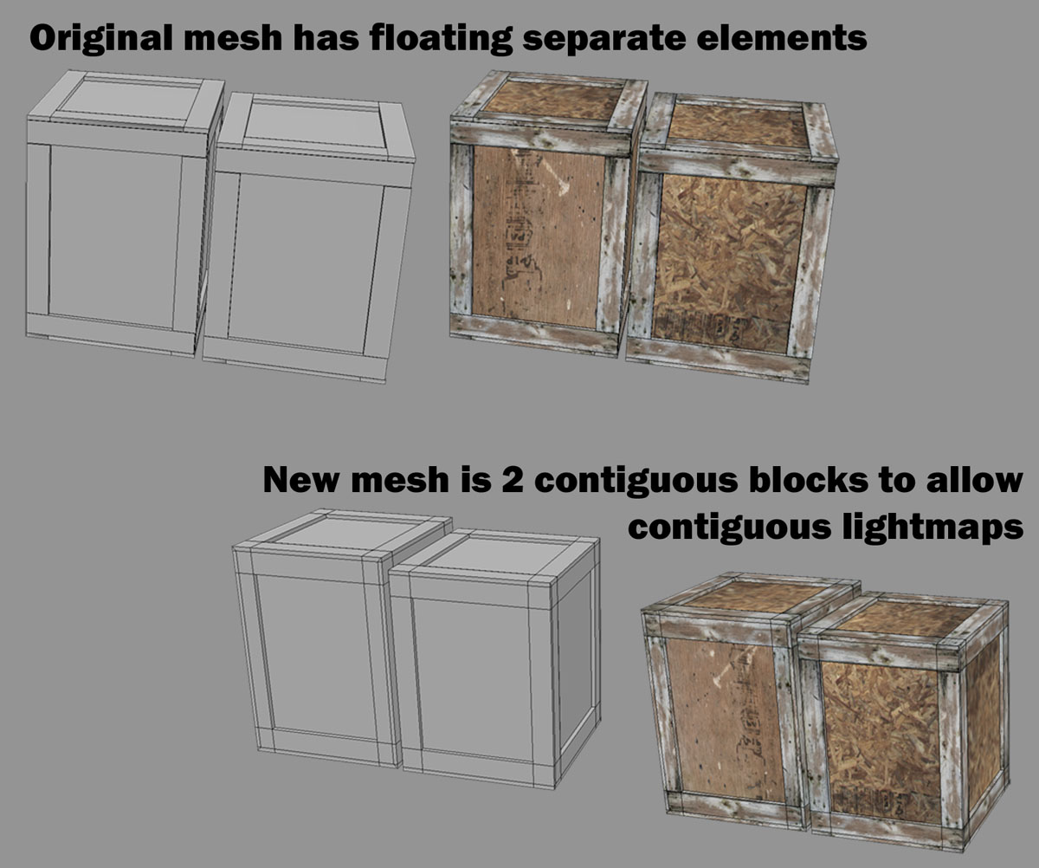

Slide 38
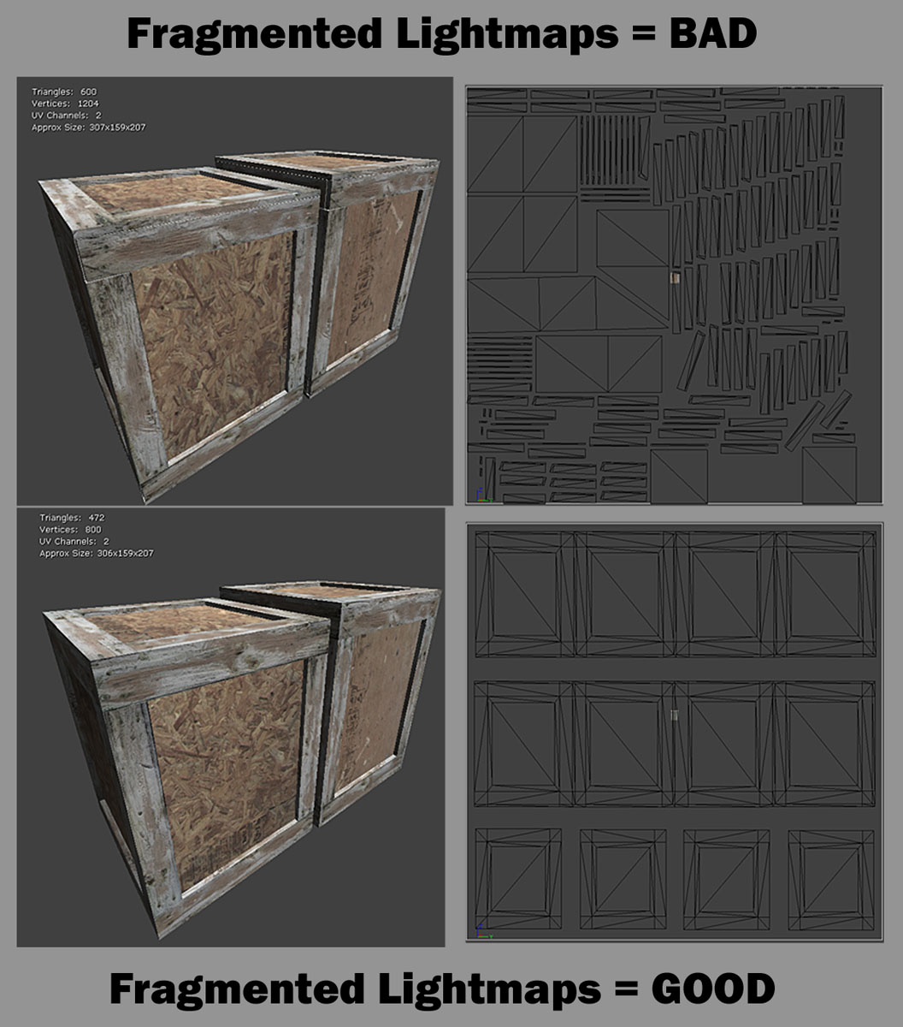

Slide 39
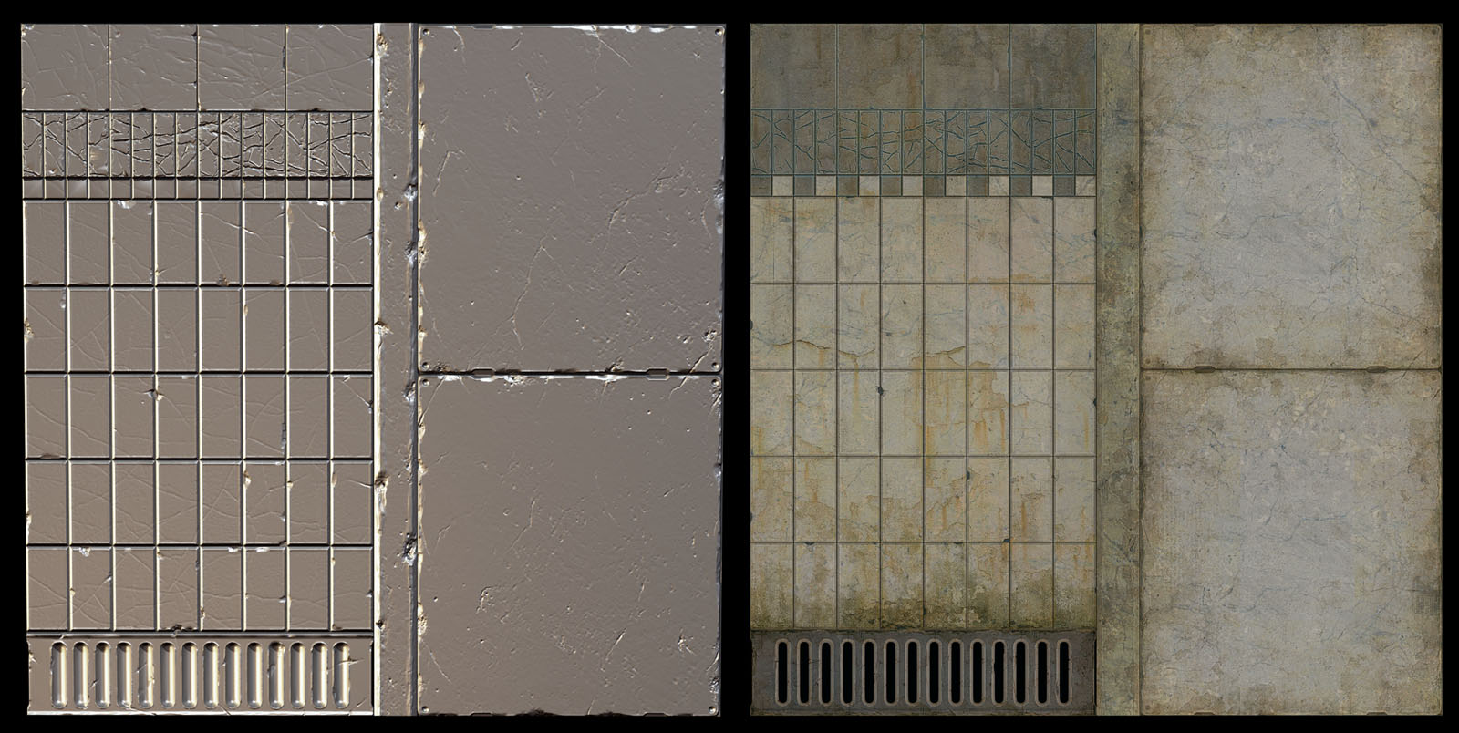
Boring to Look , but still the most critical part of the work

Slide 40
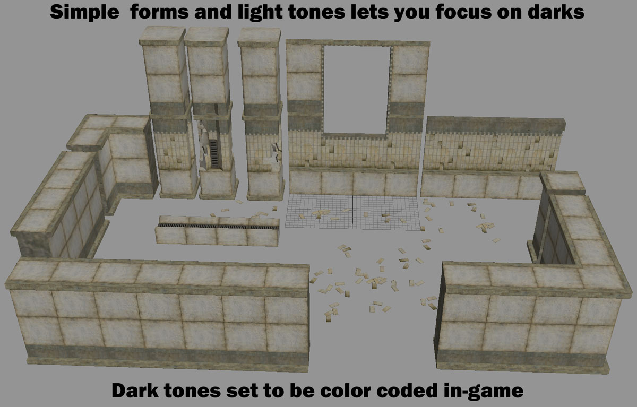

Slide 41
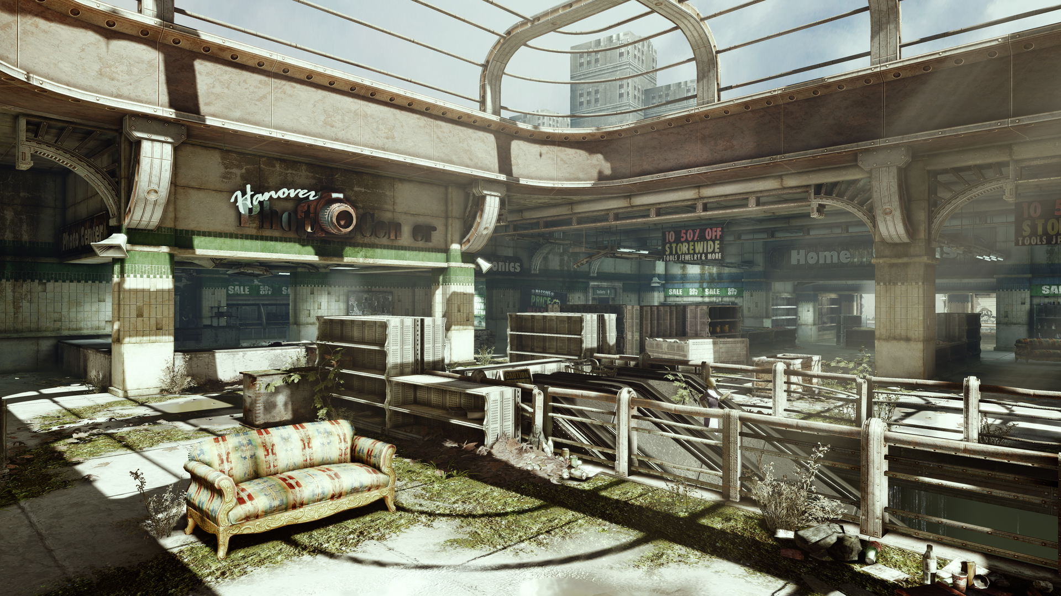

Slide 42
Summary
Think Ahead and plan it out
The GRID is your friend
It’s not about being a great modeler its about being a great problem solver
Ensure Adaptability, you need to take requests
You have to love it enough to make others love it

Slide 44
That’s the end
Thanks for listening
Kevin.Johnstone@epicgames.com
www.kevinjohnstone.com

